Slide 1
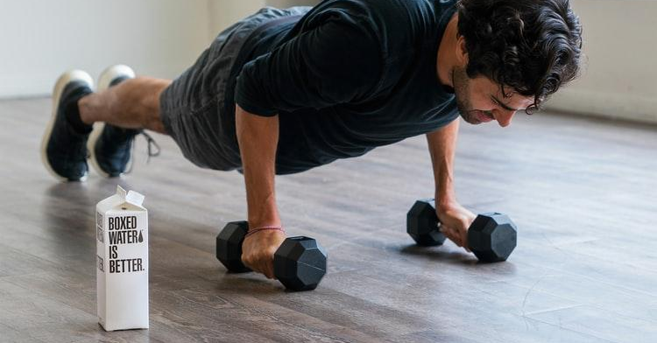
LiveFit
INFO 6150 Web Design
Final Project
Ankur Chauhan (1565993)
Dwaraganath Setti Ashok (1007680)
Aparna Anil Shelar (1009233)
Vishakha Vinayak (1550683)
Madhurima Chatterjee (1003806)
Nitish Solabannavar (1316804)

Slide 2

Overview:
A one-stop platform for fitness freaks
Purchase accessories related to gym, yoga and calorie intake
Book virtual events for home exercises, diet recipes, etc

Slide 3
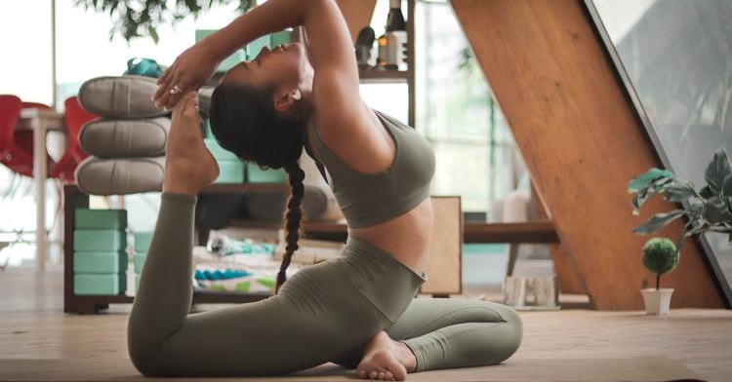
Technologies Used
React
Node

Slide 4
Features
Cart Functionality
Appointment Picker
Google Recaptcha
User Analytics & Admin Console
Payment
Subscription

Slide 5
Components
Card
Header
Footer
Accordion
Jumbotron
Carousel

Slide 6
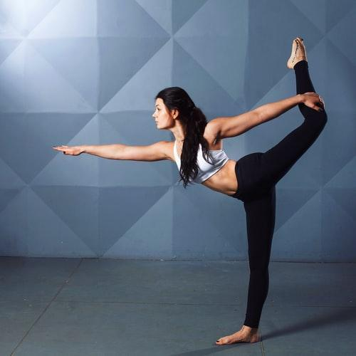
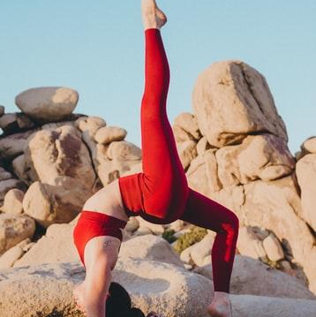
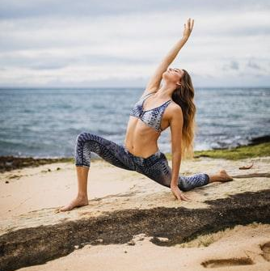
services
PayPal
Nodemailer
JWT validation

Slide 7

Admin Console
23
Home
Users
Admin can see detailed analysis on transaction, user count and products purchased
34
Products
27
Transactions

Slide 8
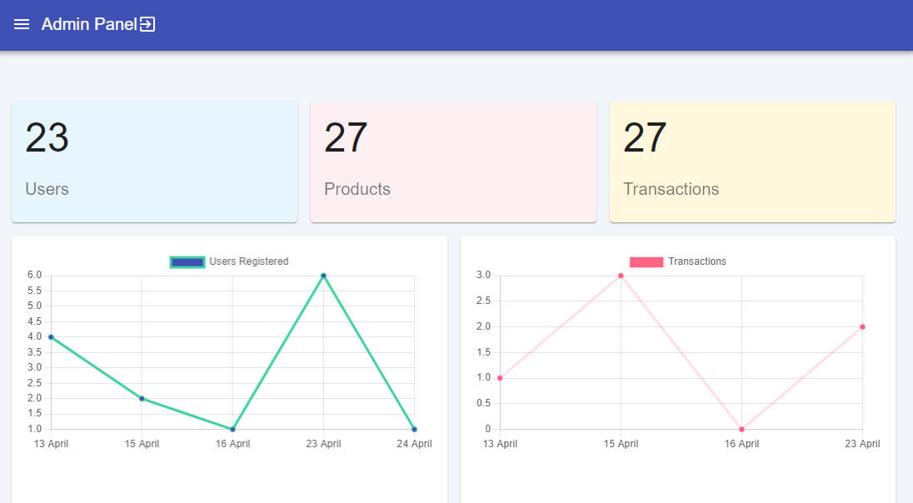

Slide 9
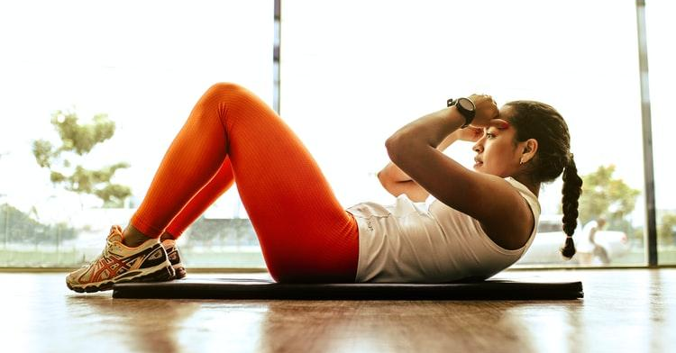
Admin - Product Catalog
List of products added
View
Resize
Based on column name
Based on different size
Filter
Export
Based on ID and value
Export all the product data in csv

Slide 10
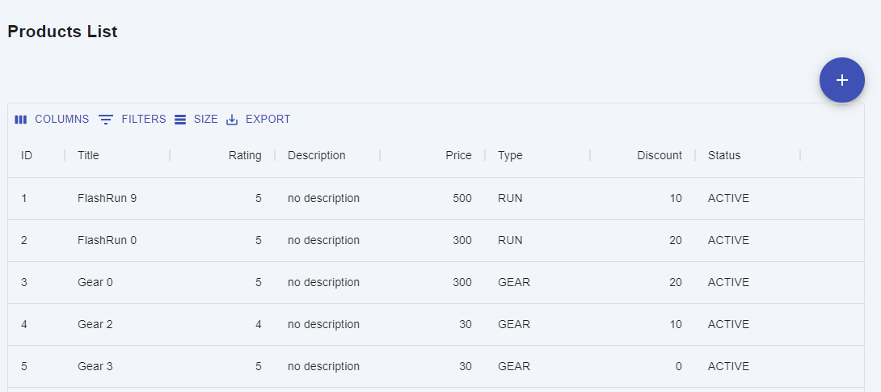

Slide 11
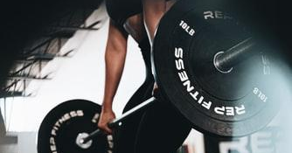
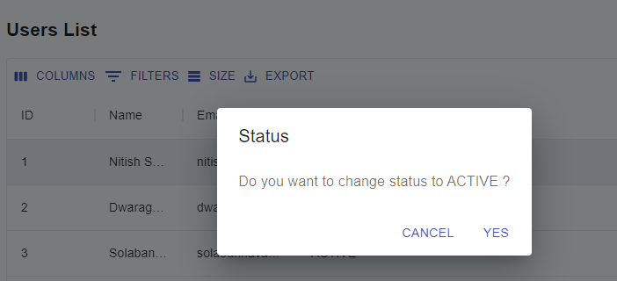
Admin - Users List
Display list of users
Change the status of users from active to
inactive and vice-a versa

Slide 12

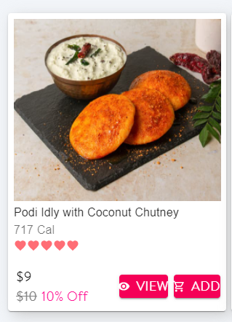
Accessories Features
Zoom Product
Filter based on category
View Product
Display Ratings

Slide 13
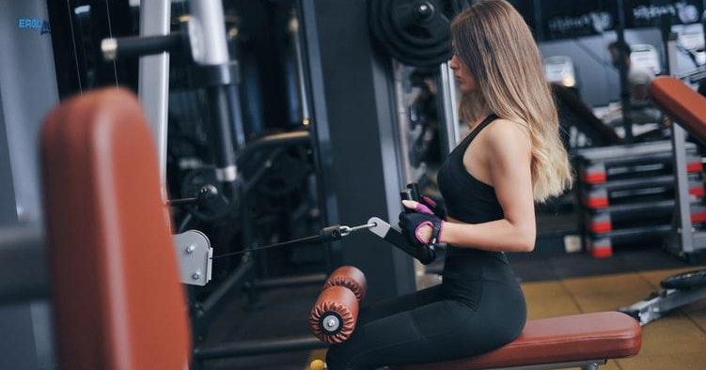
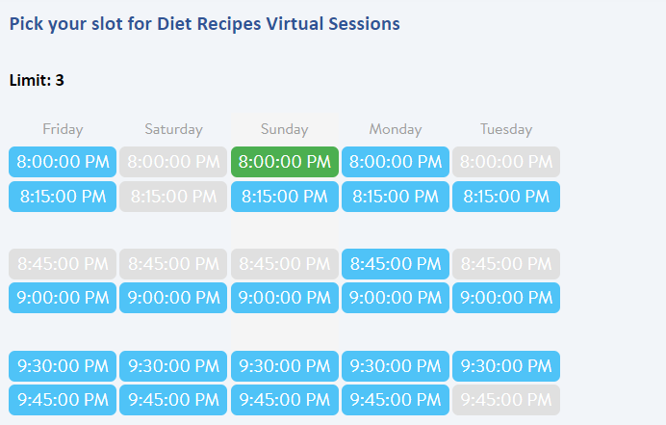
Schedule an Appointment
Available Dates
Booked Dates
Selected Dates

Slide 14
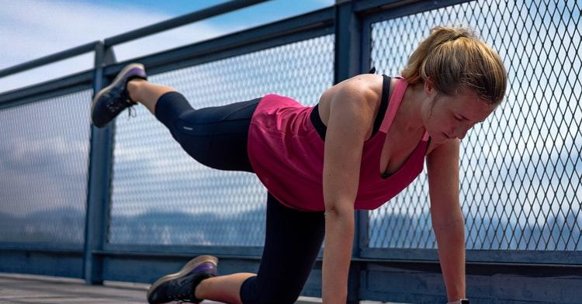
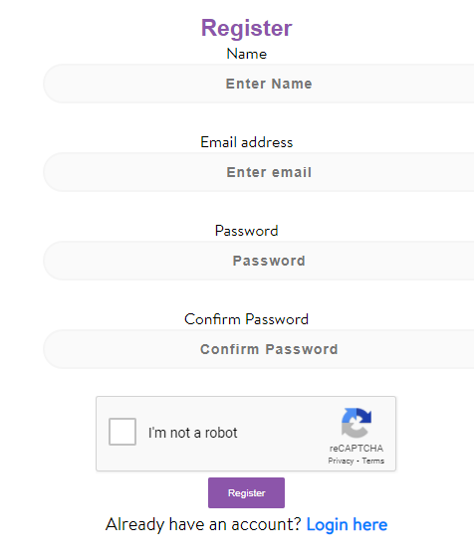
Google Recaptcha
Allows user registration on successful captcha validations

Slide 15
Email Subscription & social media

Slide 16
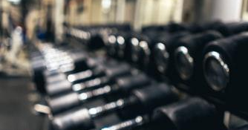
THANK
YOU

